Slide 1
Part 4
Assessing normality when you have two repeated measures
The Wilcoxon signed-rank test

Slide 2
Assessing the assumption of normality
Q-Q plots and Shapiro-Wilk test used
The difference between timepoint 1 and timepoint 2 should be normally distributed
Calculate a difference score for each participant and assess normality of this difference score

Slide 3

Research question
Does day of the week affect how much fizzy drinks an individual consumes (Saturday vs Monday)?
Participant | Saturday | Monday
1 | 630 | 46
2 | 810 | 21
3 | 630 | 542
4 | 740 | 745
5 | 416 | 411
6 | 226 | 226
7 | 468 | 304
8 | 753 | 23
9 | 274 | 177
Participants come into the lab for the day and are offered unlimited fizzy drinks. Does the amount of fizzy drink consumed (in ml) differ depending on the day of the week?
Same participants in each condition!

Slide 4
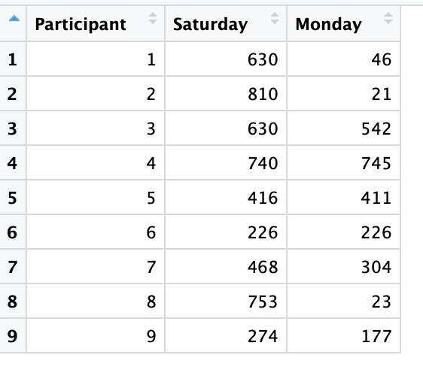
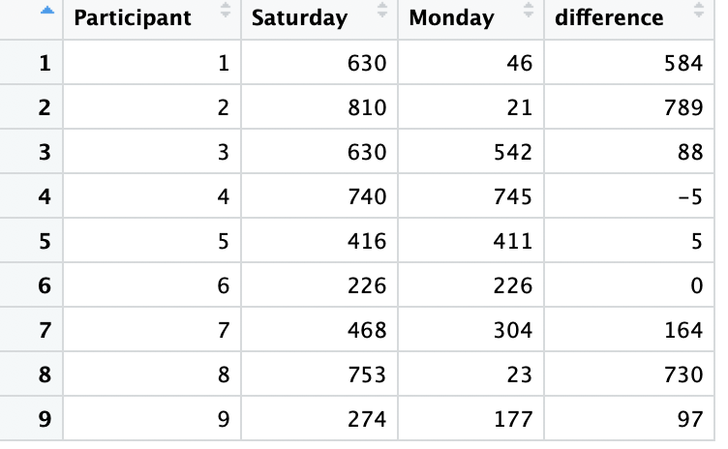
Load in the data and calculate a difference score
Load in the data:
Calculate a difference score:
Code creates a new column “difference” which is the value of Saturday minus the value of Monday

Slide 5
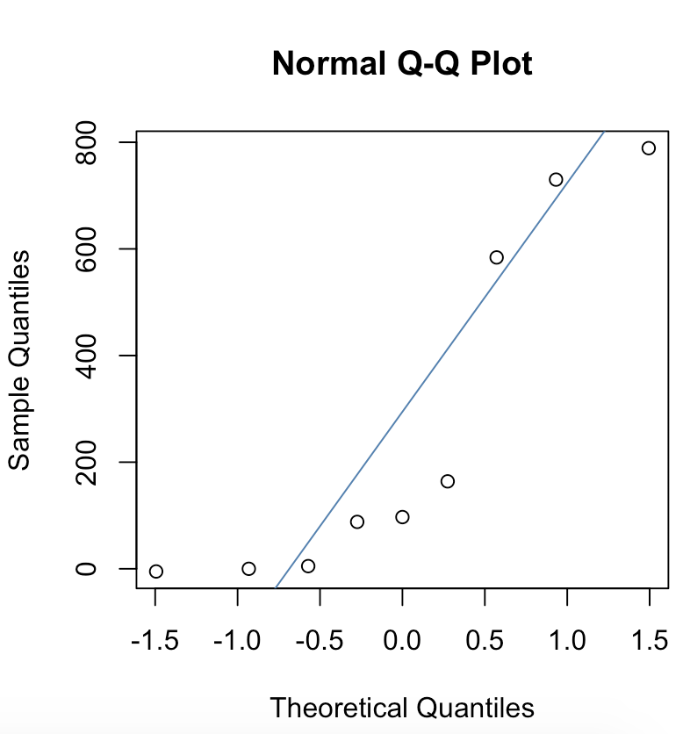
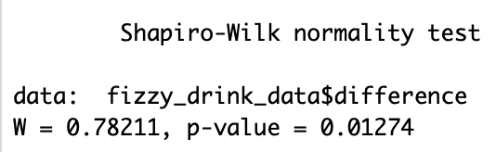
Now produce Q-Q plot and run Shapiro-Wilk test on the difference column
Q-Q plot
Shapiro-Wilk test
Normality assumption violated

Slide 6
Wilcoxon signed-rank test
Alternative to the related samples t-test
Appropriate if you have a design with only two repeated measures (all participants contribute data at both timepoints)

Slide 7
The theory behind the Wilcoxon signed-rank test

Slide 8
Step 1: Calculate the difference between the conditions
Participant | Saturday | Monday | Difference
1 | 630 | 46 | 584
2 | 810 | 21 | 789
3 | 630 | 542 | 88
4 | 740 | 745 | -5
5 | 416 | 411 | 5
6 | 226 | 226 | Exclude
7 | 468 | 304 | 164
8 | 753 | 23 | 730
9 | 274 | 177 | 97
Calculate the difference between the conditions
If there is no difference (i.e. the conditions are equal), exclude these cases

Slide 9
Step 2: Note the sign of the difference (+ or -)
Participant | Saturday | Monday | Difference | Sign (+ or -)
1 | 630 | 46 | 584 | +
2 | 810 | 21 | 789 | +
3 | 630 | 542 | 88 | +
4 | 740 | 745 | -5 | -
5 | 416 | 411 | 5 | +
6 | 226 | 226 | Exclude
7 | 468 | 304 | 164 | +
8 | 753 | 23 | 730 | +
9 | 274 | 177 | 97 | +
Note the sign difference (+ or -)
  Here:
    + Saturday higher than Monday
    - Monday higher than Saturday

Slide 10
Step 3: Calculate the ranks
Participant | Saturday | Monday | Difference | Sign (+ or -) | Rank
1 | 630 | 46 | 584 | + | 6
2 | 810 | 21 | 789 | + | 8
3 | 630 | 542 | 88 | + | 3
4 | 740 | 745 | -5 | - | 1.5
5 | 416 | 411 | 5 | + | 1.5
6 | 226 | 226 | Exclude
7 | 468 | 304 | 164 | + | 5
8 | 753 | 23 | 730 | + | 7
9 | 274 | 177 | 97 | + | 4
Rank as before
Ignore whether the sign is positive or negative for now
Ignore “Exclude” cases

Slide 11
Step 4: Add up positive and negative ranks separately
Participant | Saturday | Monday | Difference | Sign (+ or -) | Rank
1 | 630 | 46 | 584 | + | 6
2 | 810 | 21 | 789 | + | 8
3 | 630 | 542 | 88 | + | 3
4 | 740 | 837 | -97 | - | 1.5
5 | 416 | 405 | 11 | + | 1.5
6 | 226 | 226 | Exclude
7 | 468 | 304 | 164 | + | 5
8 | 753 | 23 | 730 | + | 7
9 | 274 | 177 | 97 | + | 4
Sum of positive ranks =
6+8+3+1.5+5+7+4 = 34.5
Sum of negative ranks = 1.5
If calculated manually, the test statistic (T) is the lowest sum of ranks
R outputs a different test statistic (V) which is equal to the sum of positive ranks

Slide 12
Running the Wilcoxon signed-rank test in R

Slide 13
Basic code to run the Wilcoxon signed-rank test
Keep output
Timepoint 1
Timepoint 2
Function to run test
Tells R data is paired (i.e. repeated measures)
Displays the model output

Slide 14
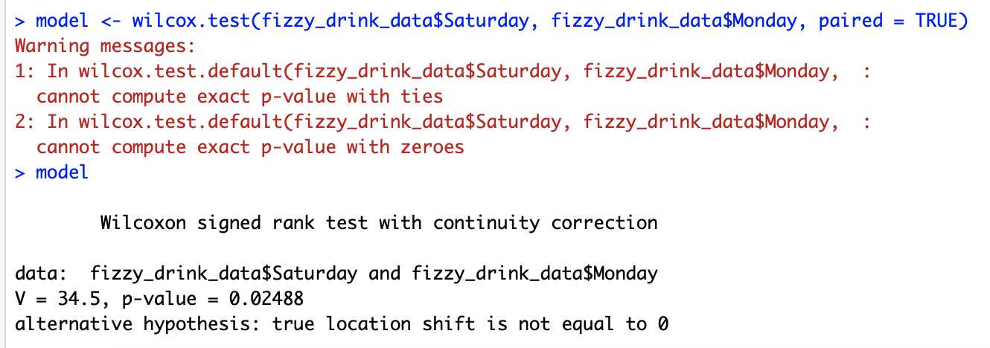
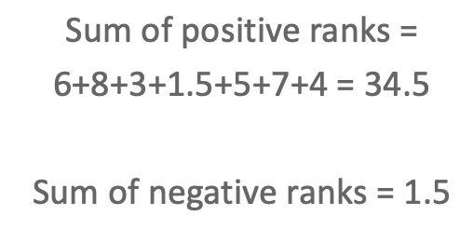
Output
V = Sum of positive ranks
What is V?

Slide 15
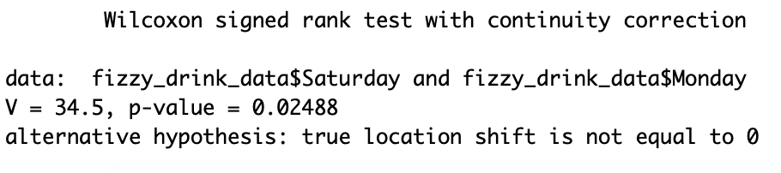
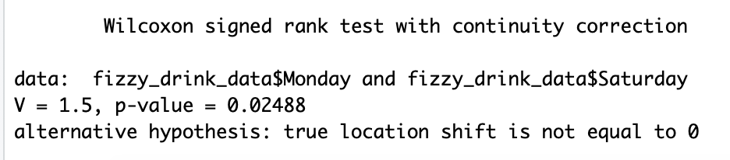
Does V differ depending on how I enter the variables into wilcox.test?
Yes – V is always the sum of positive ranks, but whether ranks are positive or negative will differ depending on the way you enter the variables into the ‘wilcox.test’ function

Slide 16
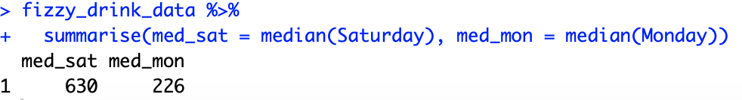
Is the difference significant?
Yes, a significant difference in the amount of soft drinks consumed on a Saturday and a Monday
In what direction?
Calculates median for each timepoint
Participants consumed significantly more fizzy drinks on Saturday

Slide 17
How is the p-value calculated?
Options: The exact method and the normal approximation with continuity correction
Tells you there are tied ranks
Tells you some differences = 0
Normal approximation with continuity correction used. If exact method was used, it would simply say “Wilcoxon signed rank test”
By default, exact method is used unless there are tied ranks, there are some cases with a difference of 0, or there are 50 or more participants overall

Slide 18

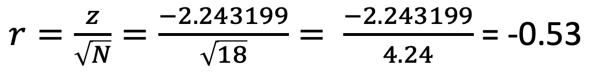
What about effect size?
$r=\frac{z}{\sqrt{N}}=\frac{−2.243199}{\sqrt{18}}= \frac{−2.243199}{4.24}$ = -0.53
Note: N = total number of OBSERVATIONS, not participants
Interpretation
 | Positive | Negative
Small | 0.1 to 0.3 | -0.1 to -0.3
Medium | 0.3 to 0.5 | -0.3 to -0.5
Large | 0.5 to 1.00 | -0.5 to -1.00
Large effect size

Slide 19
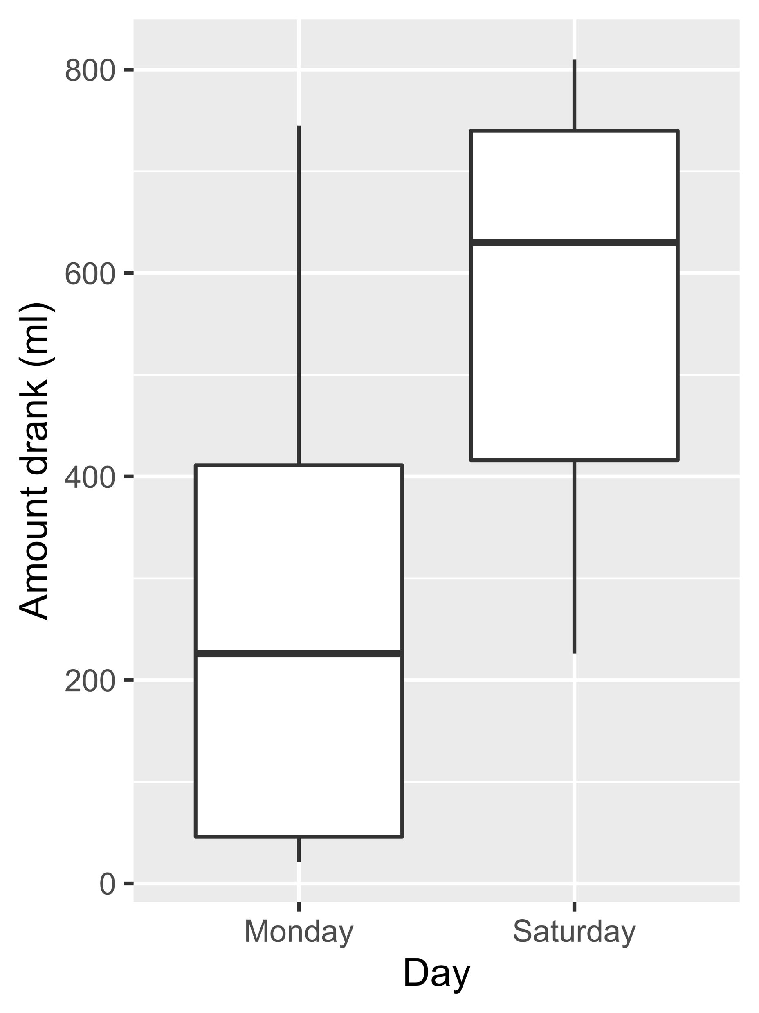
Reporting the results in APA format
A Wilcoxon signed-rank test revealed the number of fizzy drinks consumed was significantly higher on Saturday (Median = 630; Range = 226-810) than on Monday (Median = 226; Range = 21-745), V = 34.5, p = .025, r = -.53.

Slide 20
Lab preparation (~10 minutes)
Please watch the short lab preparation video prior to your lab
We will walk through an R script that runs a Wilcoxon rank-sum test and a Wilcoxon signed-rank test

Slide 21
Post-lecture activities
Now live on Moodle

Slide 22
Thank you for listening!
Please post any questions on the discussion board or the anonymous Qualtrics link.

